Slide 1
Tornadoes In Oklahoma
Disaster Relief, Property Damages, & Budgeting
Notes:
Welcome today to this presentation which explains how disastrous tornadoes can be, how they impact Oklahoma on a yearly basis, and advice for how the state budget should be adjusted for a more effective emergency response and rebuilding effort.

Slide 2
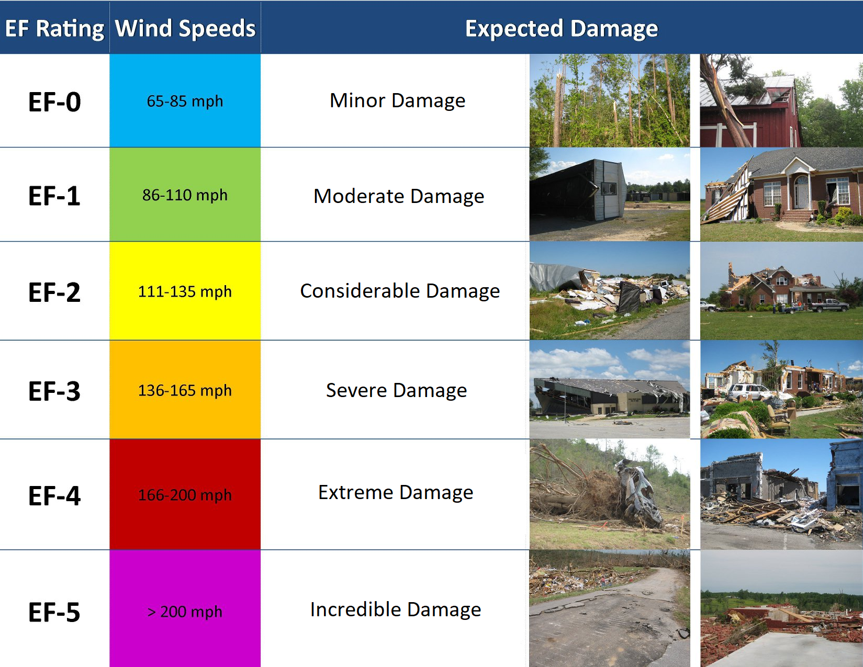
Tornadoes Are Classified On The Pearson-Fujita Scale (EF-0 to EF-5)
Notes:
The severity of a tornado is classified on the Pearson-Fujita Scale, which ranges from EF-0 (70 mph winds and minor damages) to EF-5 (over 200 mph winds and incredible damages).

Slide 3
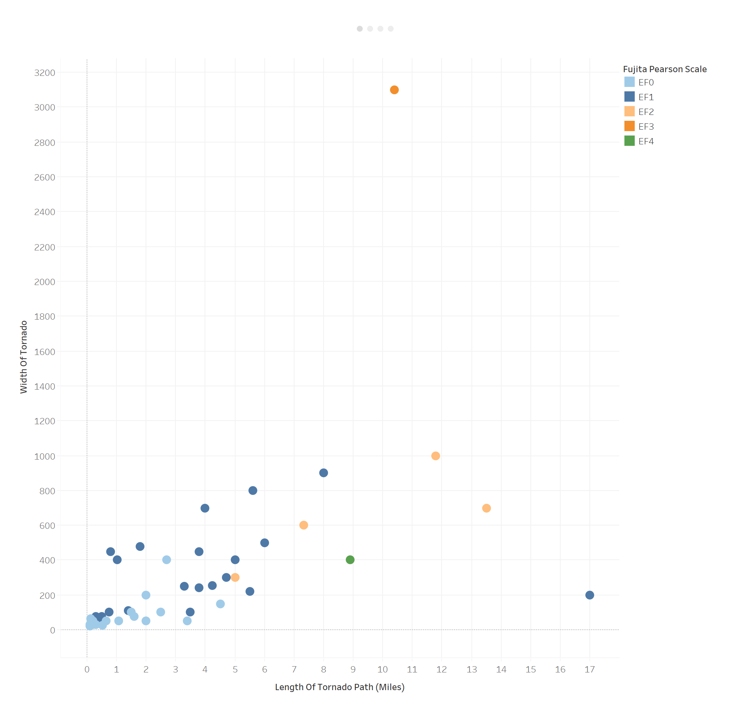
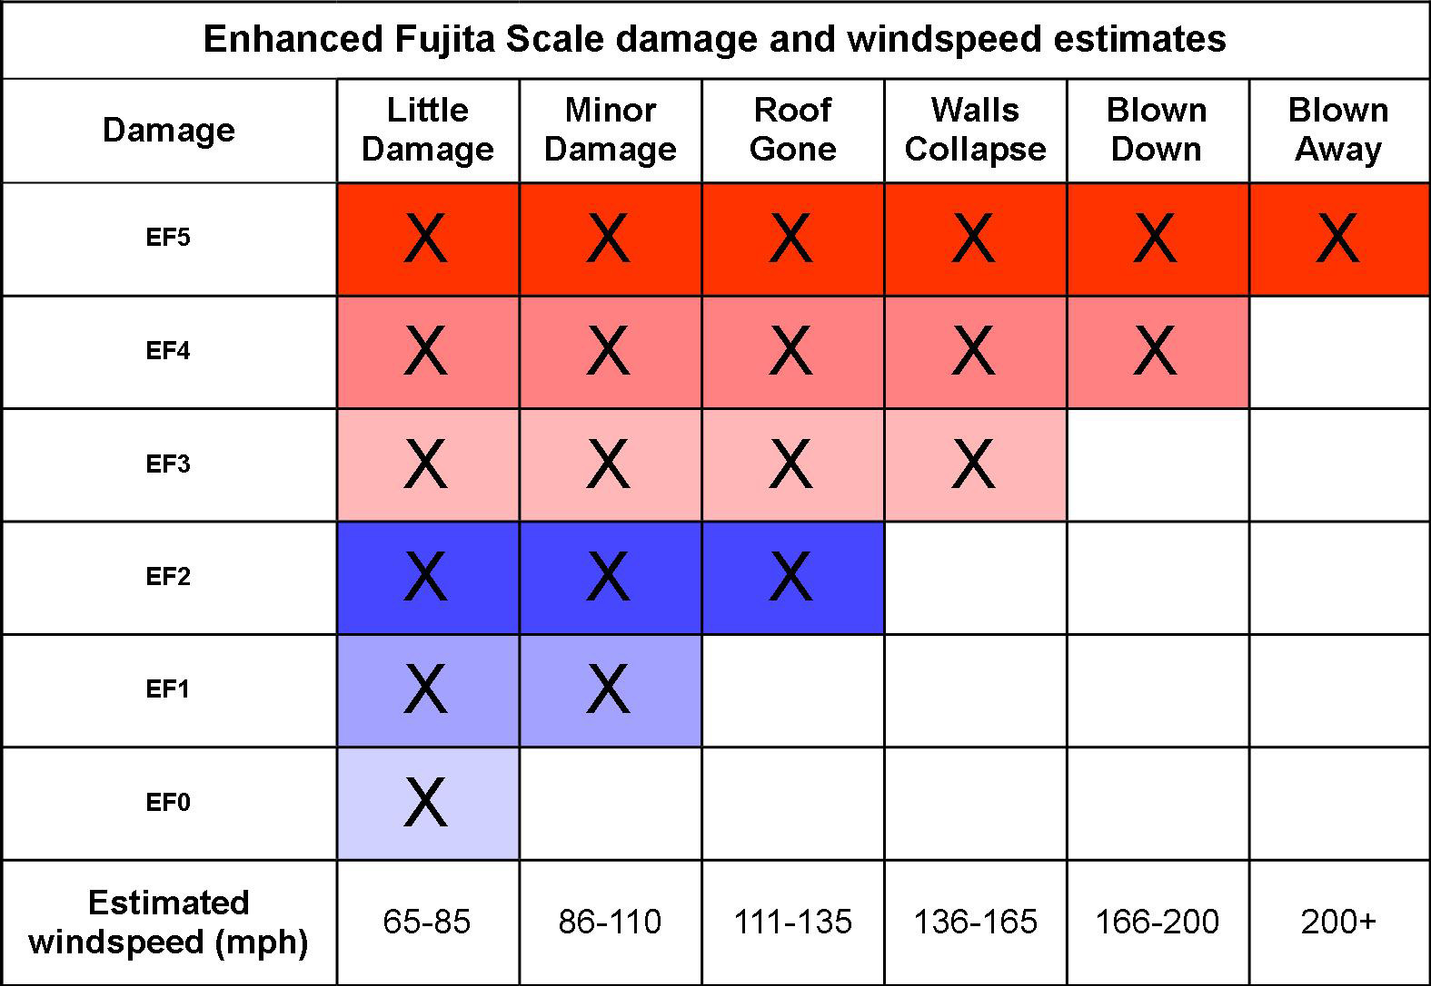
A tornado’s width and path length are good indicators of damage, but smaller tornadoes with faster windspeeds can cause more damage than larger ones.
Notes:
A tornado can be measured by its width and the length of its path. These two measures are good indicators of how much damage is caused, but smaller tornadoes with faster windspeeds can cause more damage than larger ones, and would thus be rated higher on the Fujita-Pearson Scale.

Slide 4
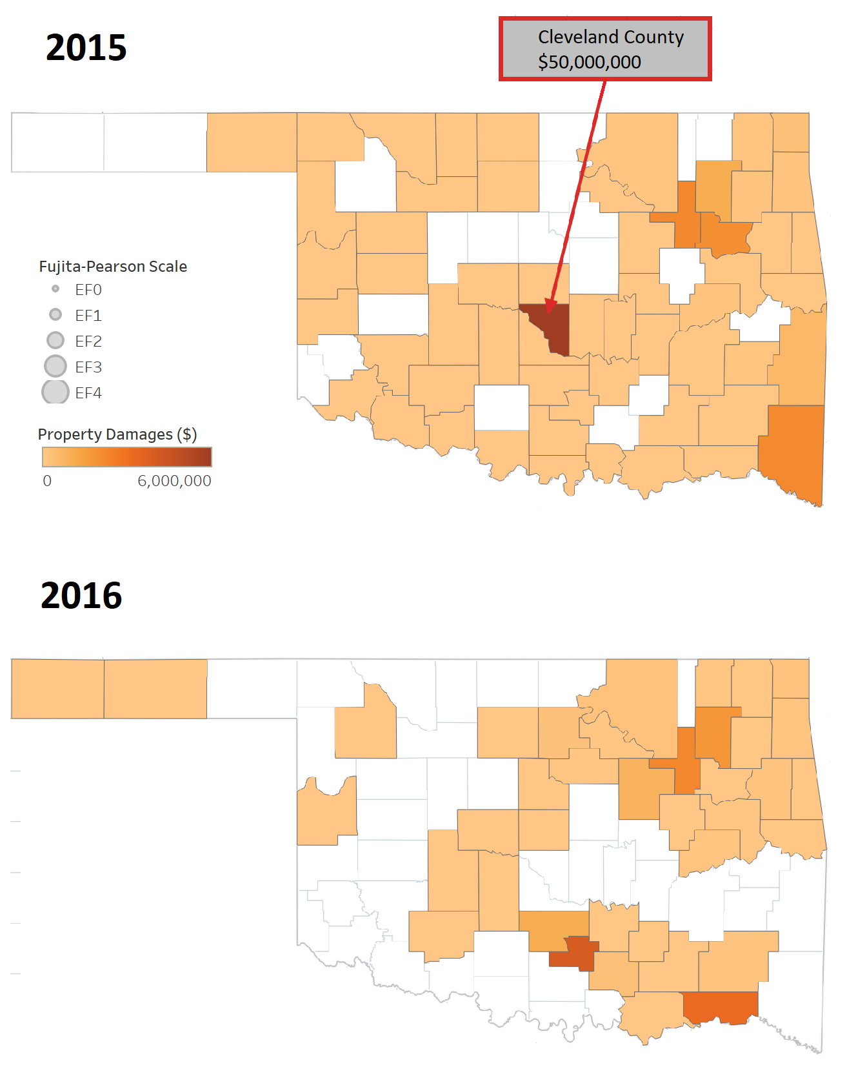
Property Damage Statistics
24 tornadoes per year in Oklahoma
17 in 3-month stretch: April, May, June
More than half of Oklahoma counties experience a tornado each year, but usually only a handful see considerable property damages, based on the most severe tornadoes or clusters of tornadoes
Notes:
These two maps show property damage totals for all Oklahoma counties from 2015 and 2016. In this two year period, there were 48 total tornado episodes, or 24 per year. Of these 48 episodes, 34 took place during the 3-month stretch of April, May, and June. Any county that has a shade of orange experienced at least one tornado in that given year. As you might be able to see, a majority of Oklahoman counties experience a tornado each year, however most of those counties only see minimal property damages. There are only a handful of counties each year that were hit hard enough by a tornado that they saw considerable property damages. One such county, Cleveland County, saw $50,000,000 of property damages in 2015.

Slide 5
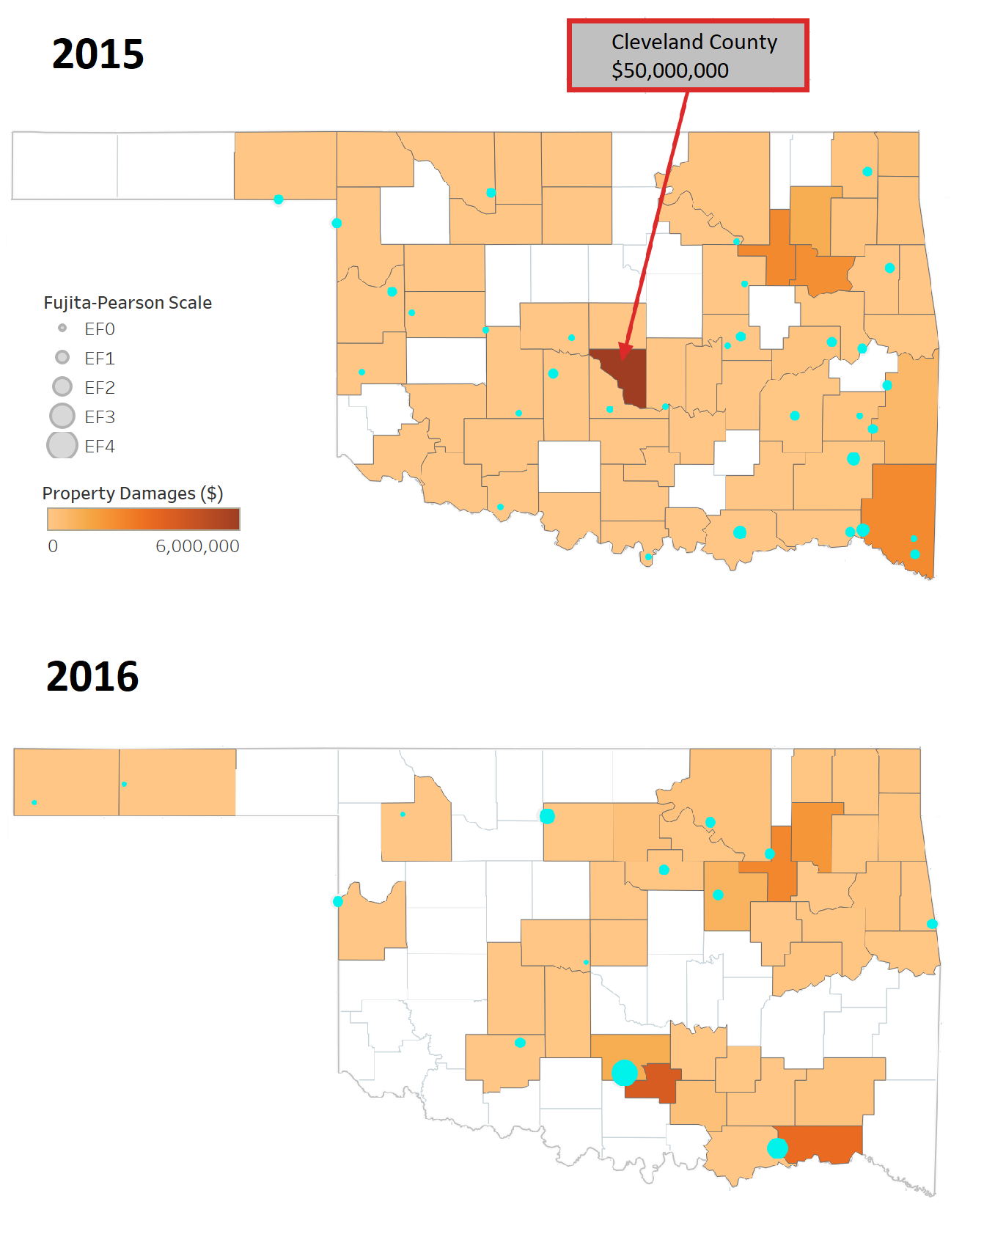
Property Damage Statistics
24 tornadoes per year in Oklahoma
17 in 3-month stretch: April, May, June
More than half of Oklahoma counties experience a tornado each year, but usually only a handful see considerable property damages, based on the most severe tornadoes or clusters of tornadoes
Points = beginning location of individual tornado episodes
Up to $40 Million in statewide property damages per year
EFO – about $10K each
EF1 – about $50K
EF2 – about $500K
EF3 – about $1M
EF4 – about $3M
EF5 – $5M or more?
Notes:
When we add the locations of tornado episodes, and size them based on their Fujita-Pearson Scale, you can see that the most property damages are caused by either the most severe tornadoes or clusters of smaller tornadoes. Based on the 2015 and 2016 tornado data, Oklahoma can expect up to $40,000,000 in statewide property damages each year. When you break down the typical property damage totals by a tornado’s Fujita-Pearson Scale rating, it is clear that damages increase exponentially and therefore the most severe tornadoes will require a large majority of emergency response and funding.

Slide 6
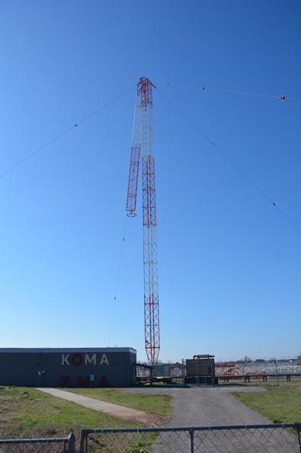
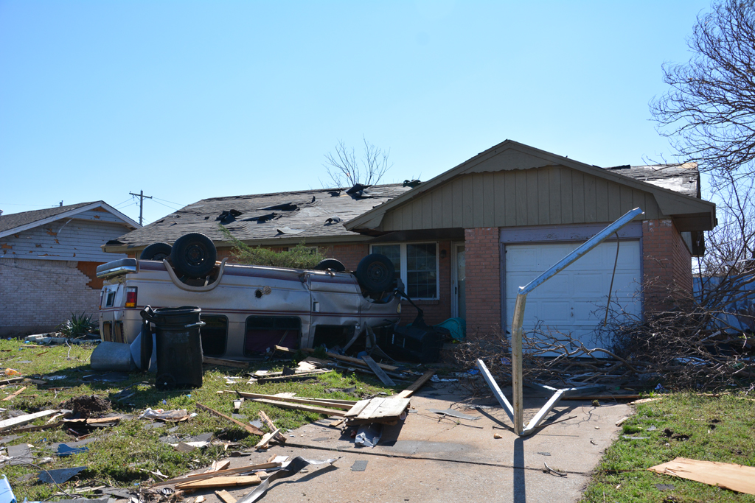
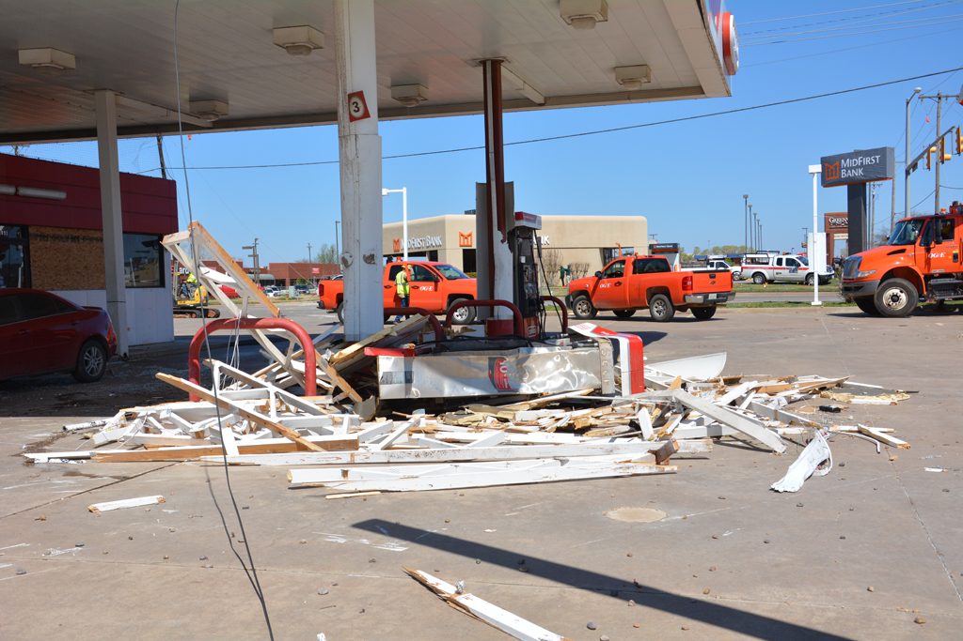
Cleveland County, March 25, 2015
Notes:
These pictures are from the Cleveland County tornado that caused $50 million in property damage. Cars flipped, roofs blown away, radio tower collapsed, and gas station destroyed.

Slide 7
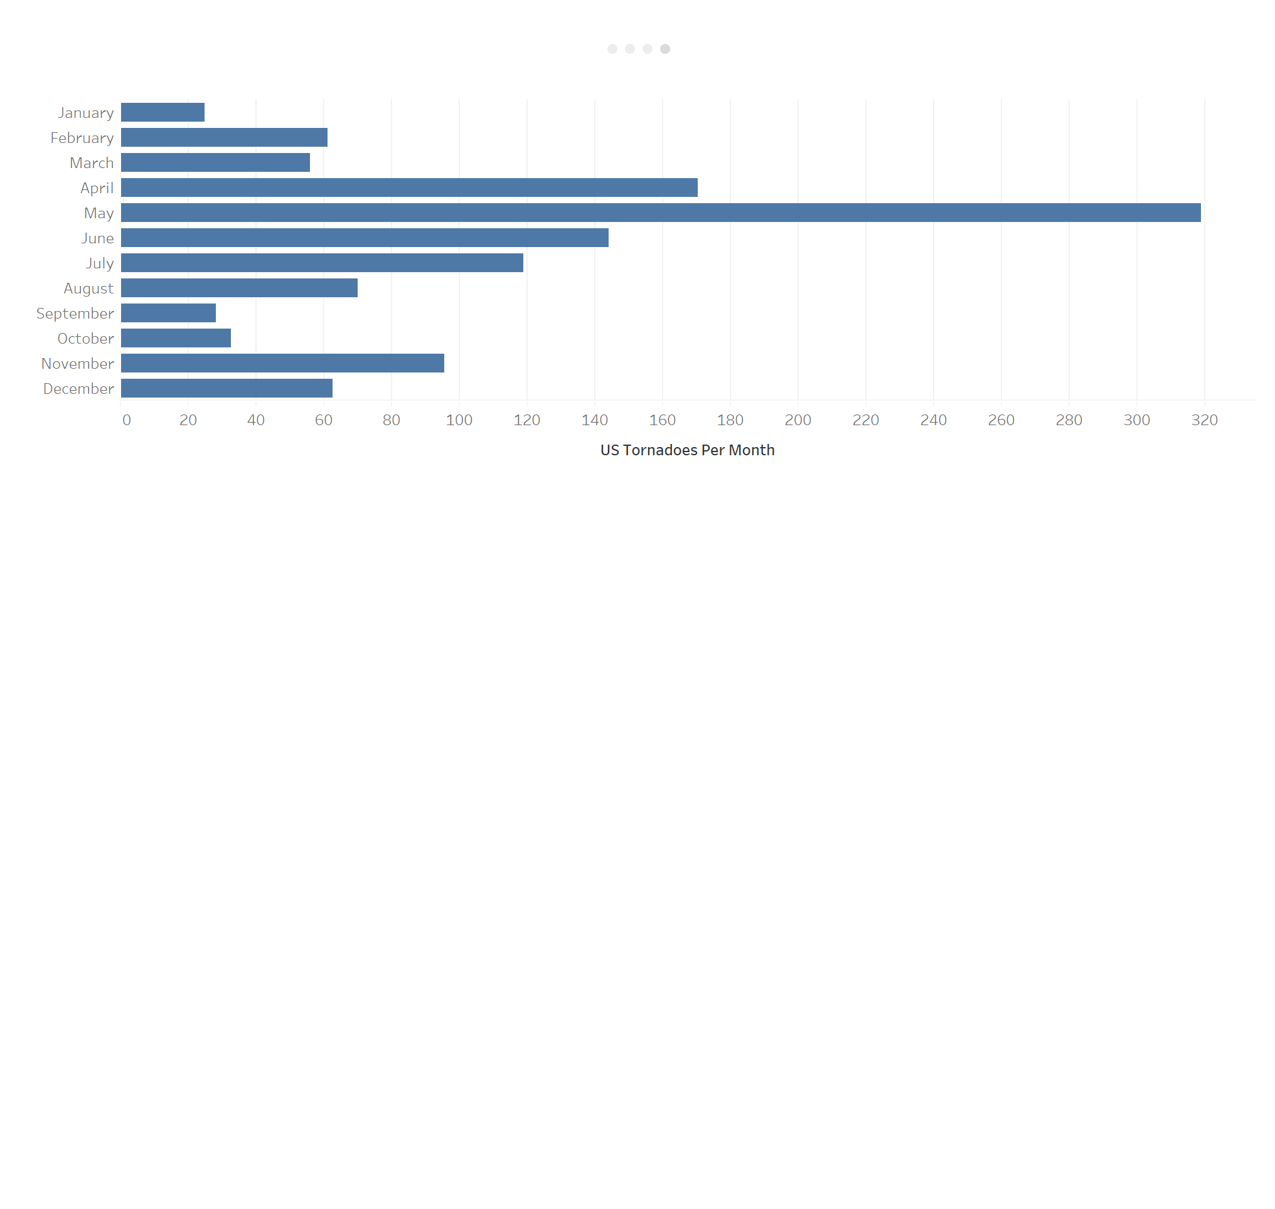




Peak Tornado Season
April – 14.4%
May – 27.0%
June – 12.2%
Total – 53.6%
Notes:
Based on the data from all US, which is backed up by our data from Oklahoma, over 50% of tornadoes occur in the 3-month period from April to June, and less than 50% of tornadoes occur in the 9-month period from July to March. Although they are sporadic and unpredictable, the 3-month period of April, May, and June can be considered Peak Tornado Season.

Slide 8
Budget Recommendations
Yearly
25x emergency supplies and staffing costs
$2 Million for immediate restoration of public buildings and facilities
$10 Million for ongoing community rebuilding efforts
Peak Season (April – June)
18x emergency supplies and staffing costs
Increased staffing capacity by 50-100%
$400,000 per month for immediate restoration of public buildings and facilities
$1 Million contingency fund
Expanded permissions for agencies to use their own budgets for disaster needs
Notes:
Now that we know more about the damages that tornadoes can cause and how they impact Oklahoma on a yearly basis, we can make some recommendations as to how the state budget should be allocated to optimize the emergency response and rebuilding effort. Due to the average number of tornadoes per month, we should be prepared to allocate emergency supplies and staffing costs 25 times per year, and 18 of those times are expected to be during peak tornado season. Additionally, increased staffing capacity will be required during peak tornado season due to increased volume.
There must be funds in the budget that provide the ability for public buildings and facilities to be immediately restored. We recommend these funds reach $2 Million per year and $1.2 Million during peak tornado season alone.
With $40 Million of yearly statewide property damages, individuals, families, and insurance payments will not be able to cover all of the rebuilding costs. The state budget must allocate $10 Million per year towards the ongoing community rebuilding efforts.
There are two other considerations that need to be made to ensure an optimal response from all parties during peak tornado season. First, the state budget must always maintain a reserve of at least $1 Million that can be used as a contingency fund for years where peak tornado season is especially damaging. Additionally for these years, standard budgets of agencies involved with emergency responses will not be sufficient. For this reason, legislation needs to be passed that allows agencies to adjust their budgets in these situations.

